Slide 1
Yet another alarm clock
Beibarys Mukhammedyarov
Maxim Zhabinets
Baiakhmet Zhekeyev
Abylay Tastanbek
Zhanibek Darimbekov

Slide 2
Components
Arduino board
4 7-segment displays
3 buttons
Speaker
Cardboard
Tape

Slide 3
Description
Alarm clock, based on timer, that forces user to solve randomly generated arithmetic problems to shut it down.

Slide 4
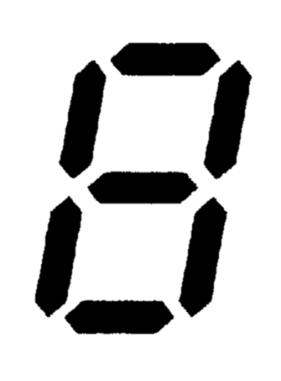
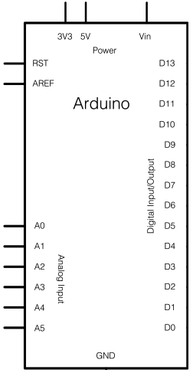
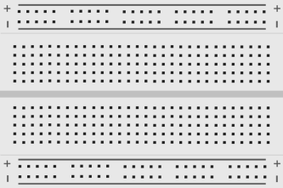


Circuit

Slide 5
Code
int reading = digitalRead(2);
if (reading != lastSetupButtonState) {
lastDebounceTime = millis();
}
if ((millis() - lastDebounceTime) > debounceDelay) {
if (reading != setupButtonState) {
setupButtonState = reading;
if (setupButtonState == 1 && mode == 1) {
mode = 2;
alltime = seconds+(minutes*60);
startTime = millis();
}else if(setupButtonState == 1 && mode == 2){
mode = 1;
}else if(setupButtonState == 1 && mode == 3){
mode = 4;
}else if(setupButtonState == 1 && mode == 5 && d4==ans){
mode = 1;
}
}
}
#define sd1t1 \
digitalWrite(25,1);\
digitalWrite(28,1);\
digitalWrite(22,0);\
digitalWrite(26,0);\
digitalWrite(23,0);\
digitalWrite(24,0);\
digitalWrite(27,0);
Total ~700 lines

